Slide 1
CS50 – WebProgramming With Python and Javascript
Project 1 New Version after 07/01/2020

Slide 2
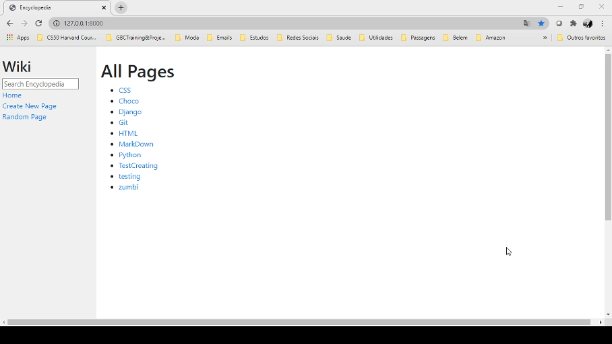

Slide 3
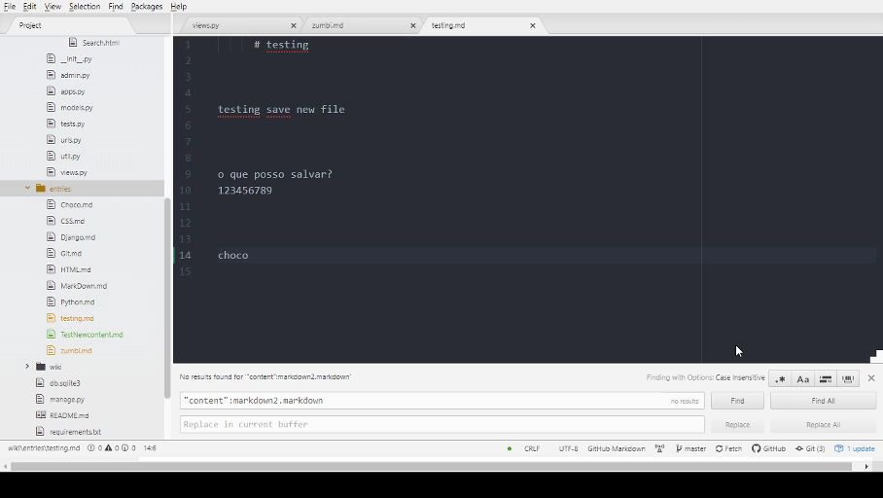

Slide 4
Thank You!

